Slide 1
Steps for Shoeing
Whitebrook Farm Pony Club Riding Center

Slide 2
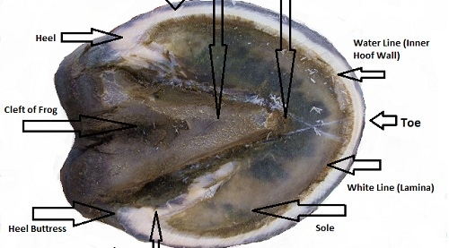
Parts of the Hoof

Slide 3
Prince Frog Flies Next Friday
Preparation
Forging
Fitting
Nailing
Finishing

Slide 4
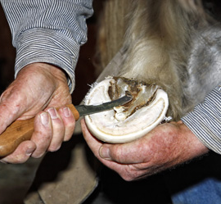
Preparation
Rest hoof on the hoof stand
Use hoof (drawing) knife to cut and trim away the sole
Use nippers to cut away excess wall
Use rasp to file down hoof
Trim Frog with hoof knife
Hoof Preparation

Slide 5
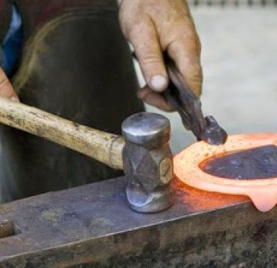
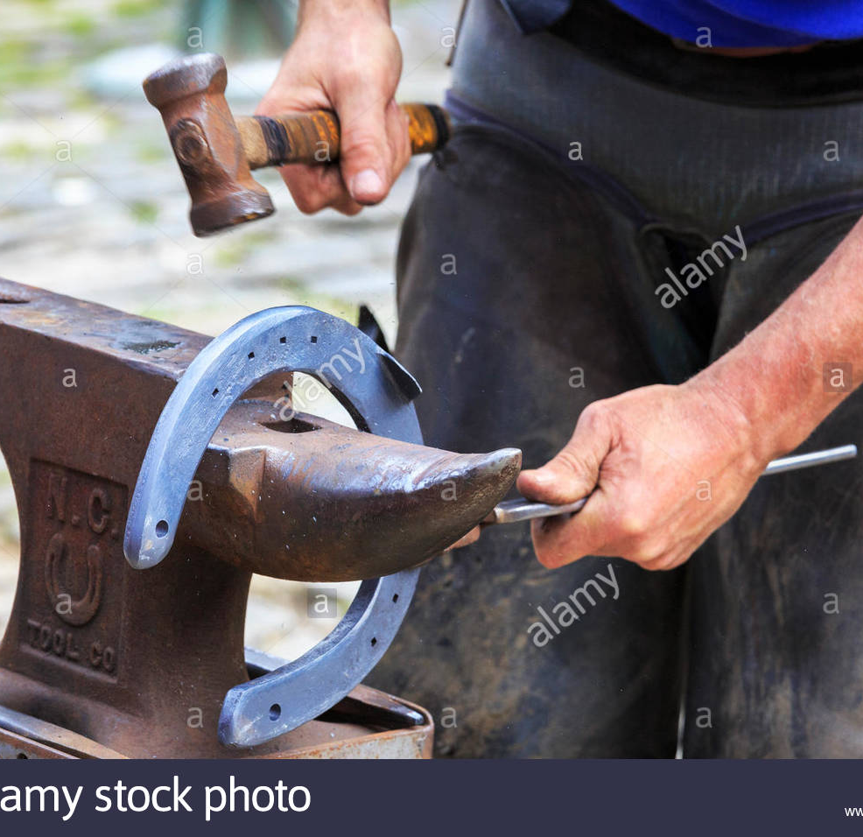
Forging
Hot & Cold Shoeing
Hot shoeing= the farrier heats the shoe in the forge.
Cold shoeing= just shapes the shoe with the hammer and anvil
Shape shoe against the anvil

Slide 6
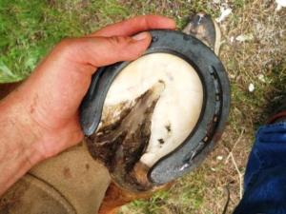
Fitting
Check shoe against hoof
Check angle of hoof and compare to other hoofs
https://www.youtube.com/watch?v=WKOyHQ7KLVY

Slide 7
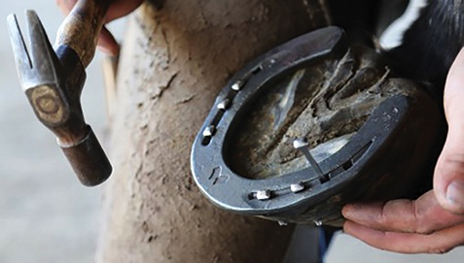
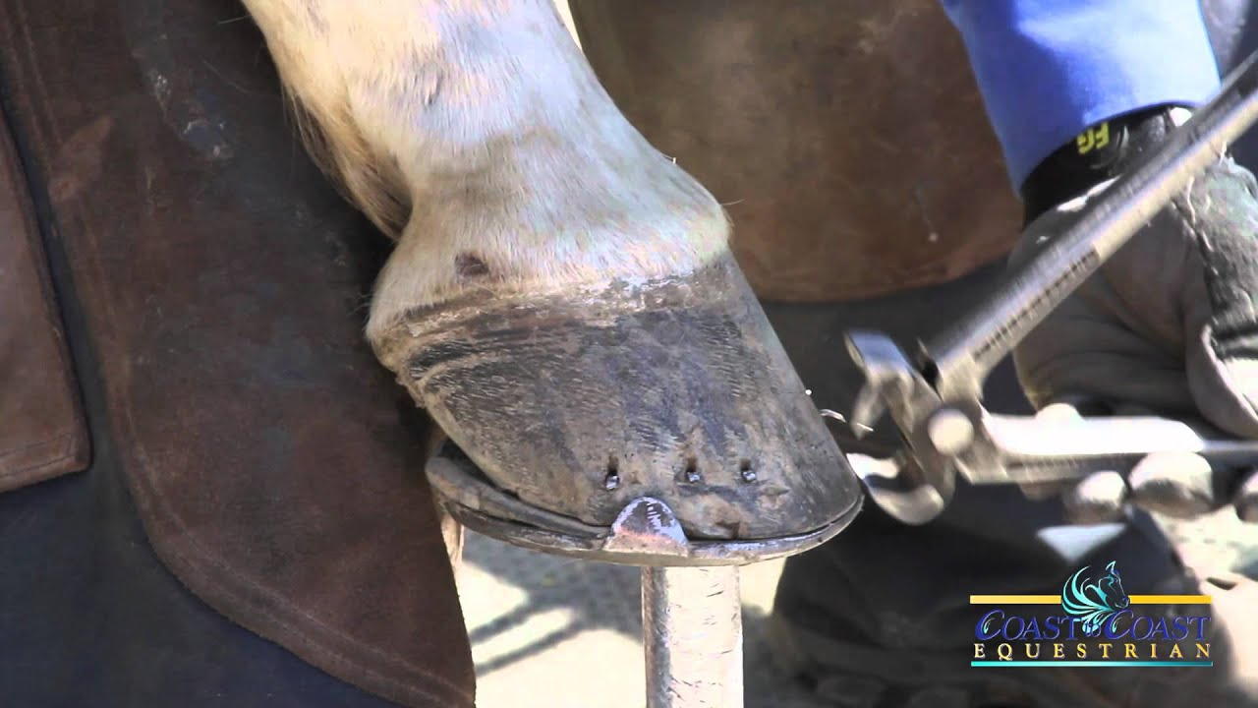
Nailing
Use hammer & nails to affix the shoe
Nails are bent over to form “clinches”
Twist sharp point of nail off with the hammer
Tighten the nails and file under the nails with a rasp
Flatten the nails with the clinchers
Smooth clinches with a rasp

Slide 8
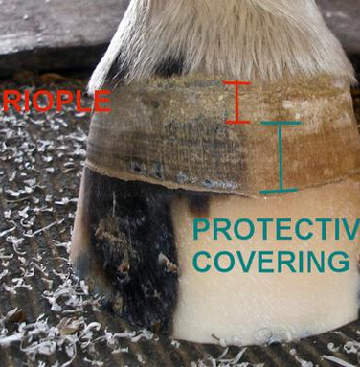
Finishing
Smooth the horse hoof around shoe with a rasp. Don’t rasp too much!
The outside of a hoof has a protective covering called the “periople”. It retains the moisture of the hoof and protects the hoof from bacteria and other problems

Slide 9
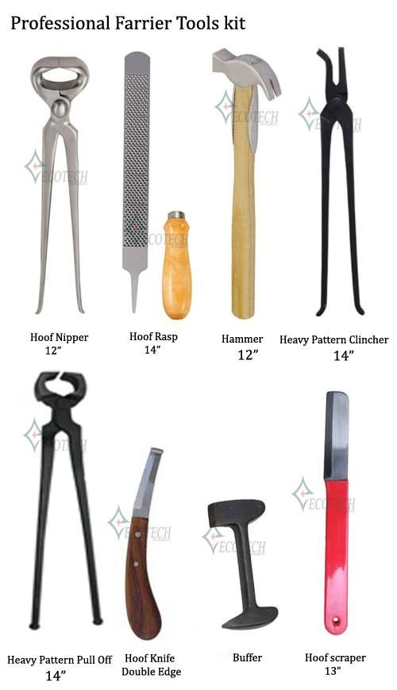

Slide 10
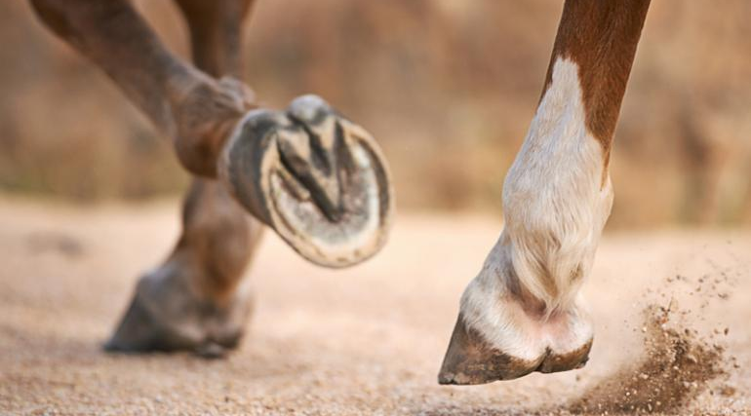
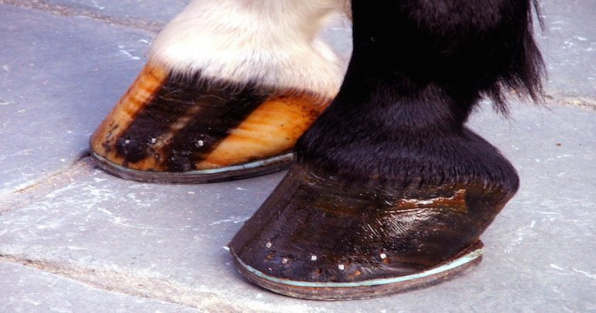
Some wear shoes and some are barefoot

